Slide 1
In this module
Definition of Processes
Definition of Threads
OS resources for processes
Working with threads

Slide 2
What is a process?
A running program in a system state
Includes: Code, data and Context
Code is all in sequential memory
Process is created by OS to keep track of
State of the running program
Resources assigned to the running program

Slide 3
State Definition (video combined with next slide)
A state is a condition that the process will spend a significant amount of time in.

Slide 4
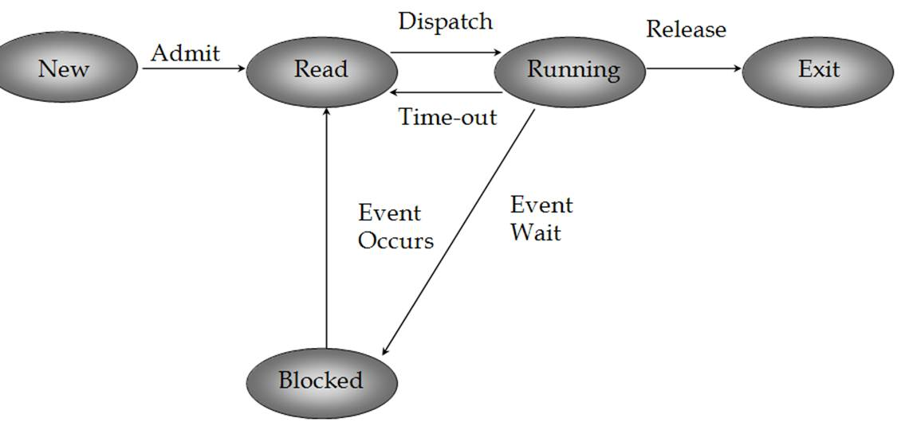
5 state process model
Notes:
Taken from: http://mcom.cit.ie/staff/Computing/prothwell/bbsos/notes/os03a_files/image001.jpg
Would be cool if we could HIGHLIGHT the state as I talk about!

Slide 5
Suspension (video with this and next slide)
The process is completely removed from main memory
Process is stored on secondary storage for future return to the point we left off
Frees main memory for other processes
Controlled by medium-term scheduling algorithm
The process will NOT be aware of the suspension
Some reasons for suspension
Debugging
Freeing main memory
Long term delay

Slide 6
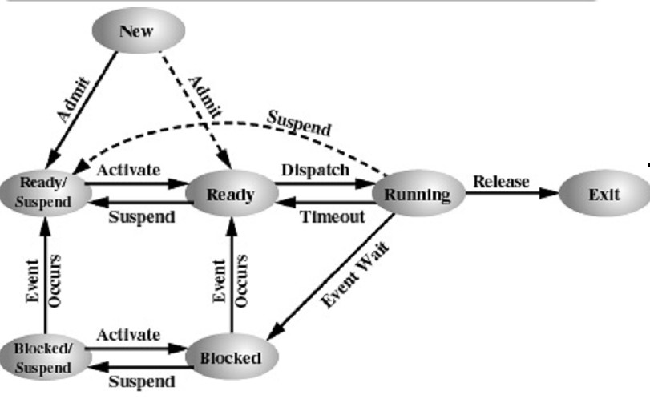
Notes:
Taken from: http://mcom.cit.ie/staff/Computing/prothwell/bbsos/diagrams/7statemodel.jpg

Slide 7
Process Image – The PCB
Includes all the information the OS needs to run and control the process
Memory Tables
Useful for paging and segmentation (to be discussed in a later module)
IO Tables
Which devices the process has access to
File Tables
Which files the process has access to
Stack
The call stack including all active functions

Slide 8
Contents of a PCB
Numeric IDs
Process ID – A numeric value unique for this process (16-bits)
PPID – Parent process ID
UID – User ID, so we know permissions
Many more!
Registers – only valid, when not in running state
Stack pointers
Scheduling
Linkages
IPC
Resources
Memory

Slide 9
Modes
Kernel
Code can execute any part of the system
User
Cannot directly access system hardware
Cannot run some CPU instructions
Cannot access any memory outside of its own
In most processors, the Program Status Word (PSW) tells the system which mode its in
Switching
Easy to go from Kernel to User
User to Kernel happens automatically upon certain events

Slide 10
Process Switching
When does a switch occur
Interrupt – A hardware signal indicating that the hardware need servicing
Trap – A condition which requires OS support
Blocking System call – A request from the process for OS support
Process Switching
Save the context into the PCB
Update accounting
Move the PCB to the appropriate queue
Choose another process
Update memory management
Restore its context
Multiprocessing means these problems become more complex and happen more often.

Slide 11
Threads
Resource ownership and Execution are two different issues
Resource ownership now becomes the only concern of the process
Execution – scheduling and running PARTS, yes there will be many, of the process become threads.

Slide 12
What is where in the multithreaded environment
Process – Process Control Block
Memory allocation
Files
Linkages
Thread – Thread Control Block
Context (processor registers)
Stack (incl. Local variables)
Access to all of the resources of the thread
Does a process exist if it has no threads?

Slide 13
Reasons for multithreading
Foreground/Background
Asynchronous processing
Synchronous processing
Infrequent tasks
Speed reading
Modular program structure

Slide 14
Performance example
File server which does IO for 80% of the task
No threads, all asynchronous = 100tps
Threads, CPU synchronous with IO = 125tps
Caching, CPU bound = 400tps
SMP, IO bound = 500tps

Slide 15
Thread states/Operation
Ready, Running and Blocked
threads don’t need New or Exit
Suspension is a process level concept

Slide 16
What are the downsides
CONCURRENCY!!!!
Over use of threads leading to confusion

Slide 17
Implementation of Threads
Kernel-Level threads
Different from Kernel Threads (where the OS is threaded)
User Level Threads
Downsides of ULTs.
Hybrid approach
Light Weight Process
Thread Scheduling details

